Slide 1
Conducting observational studies with OHDSI tools
Xintong Li
3 May 2022

Slide 2

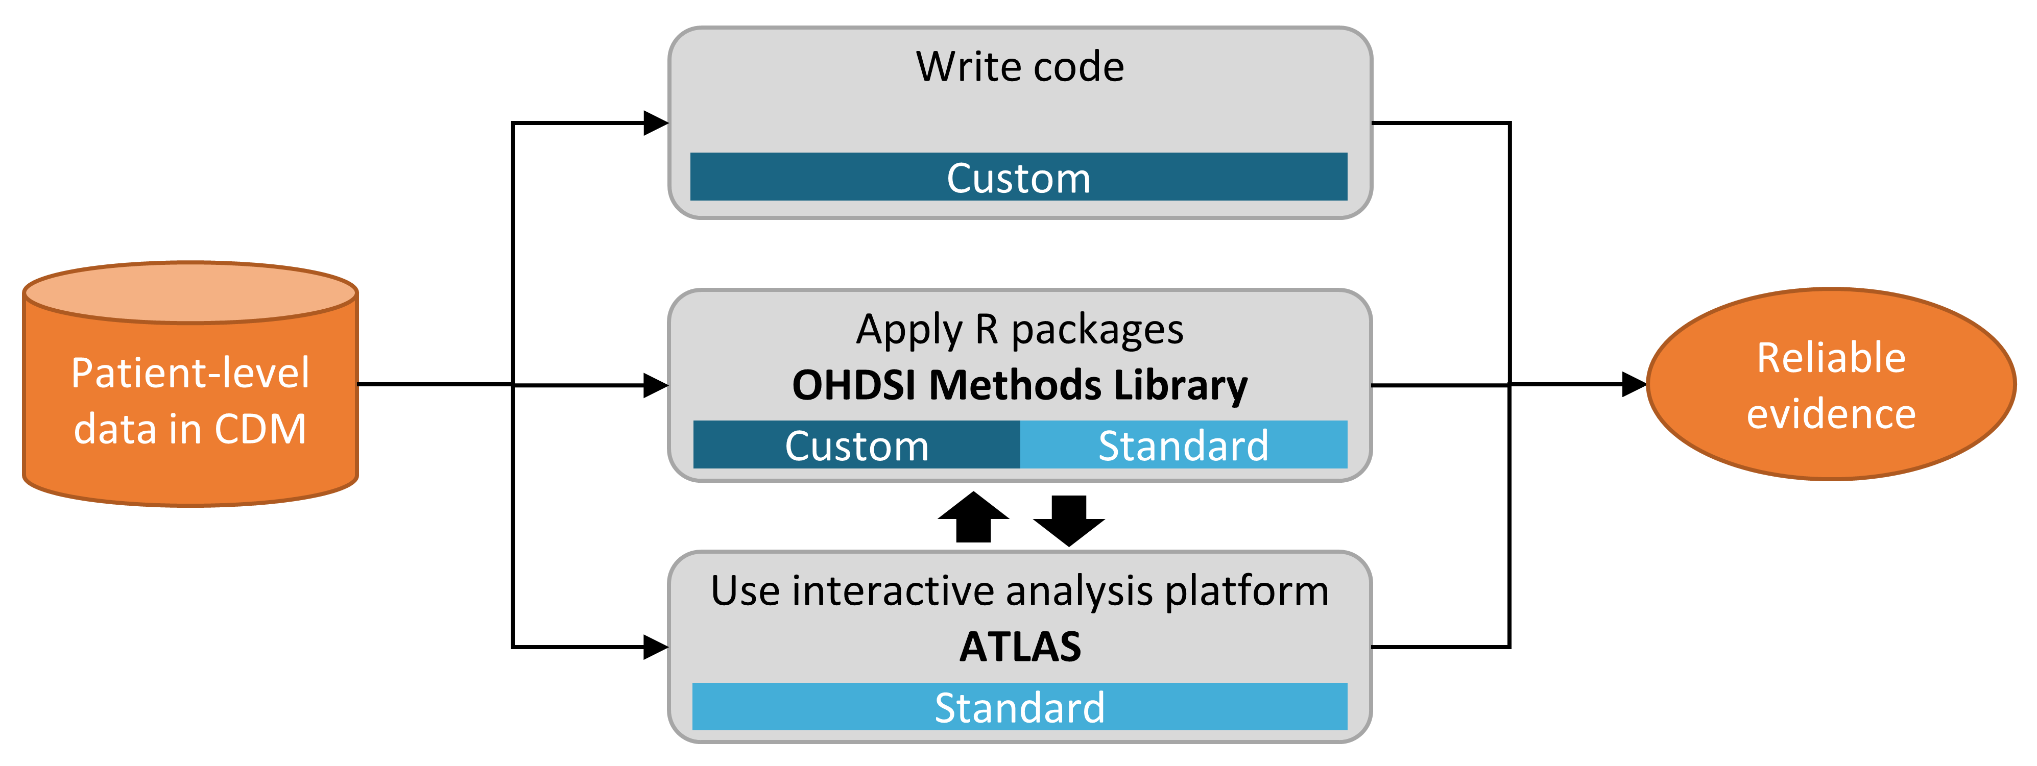

Slide 4
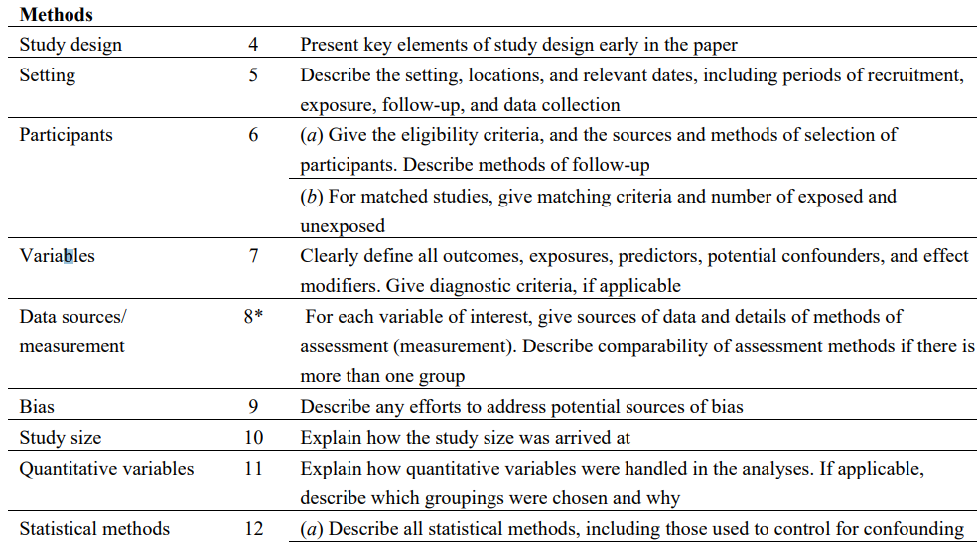
Component of an observational study (Cohort study as an example)
Cohorts
Variables
STROBE Statement—Checklist of items that should be included in reports of cohort studies
Notes:
COHORTS, COVARIATES

Slide 5
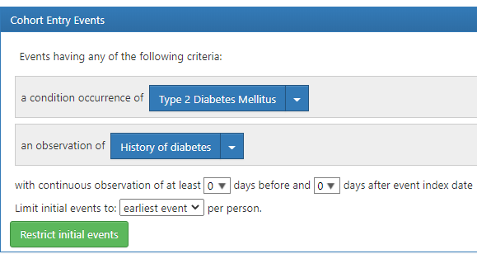
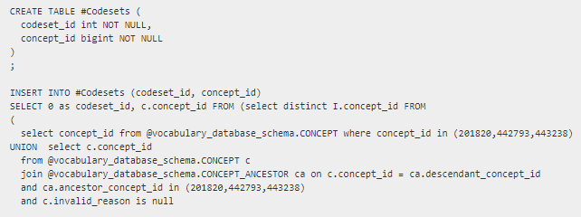
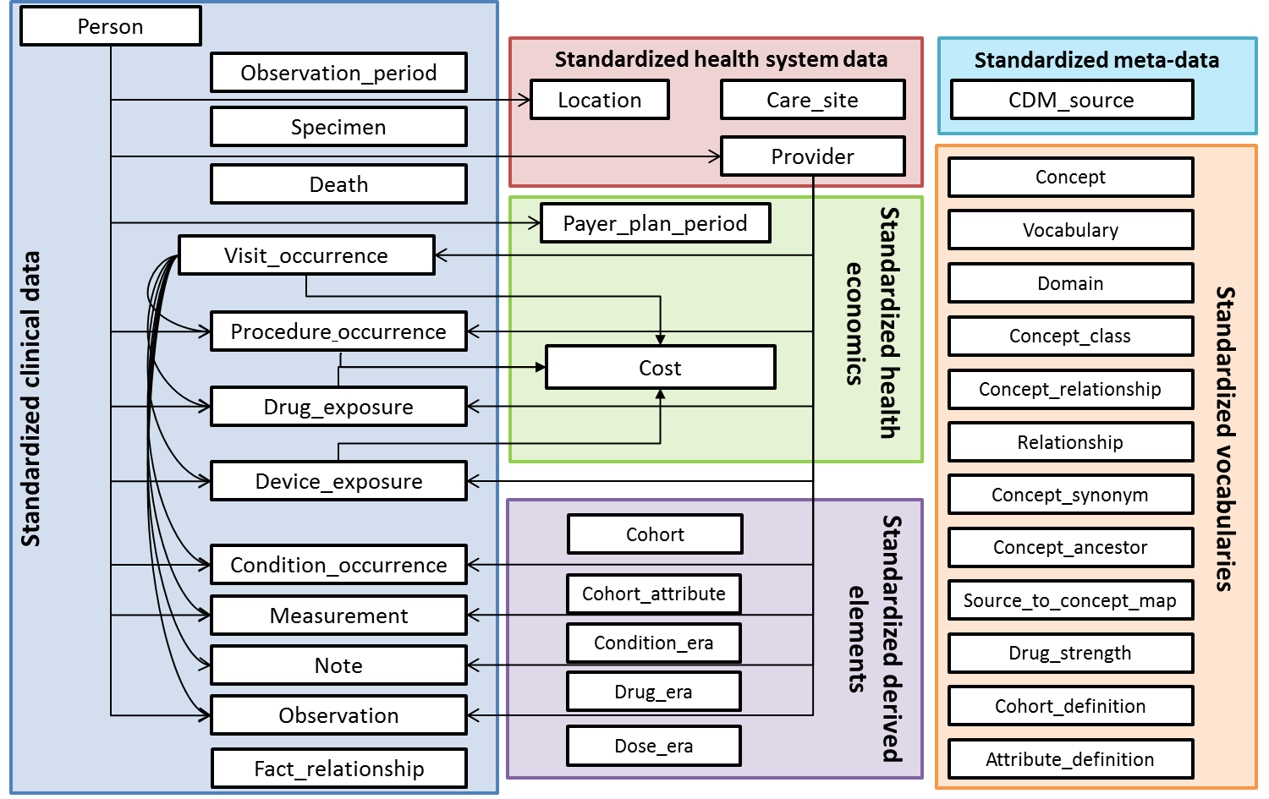
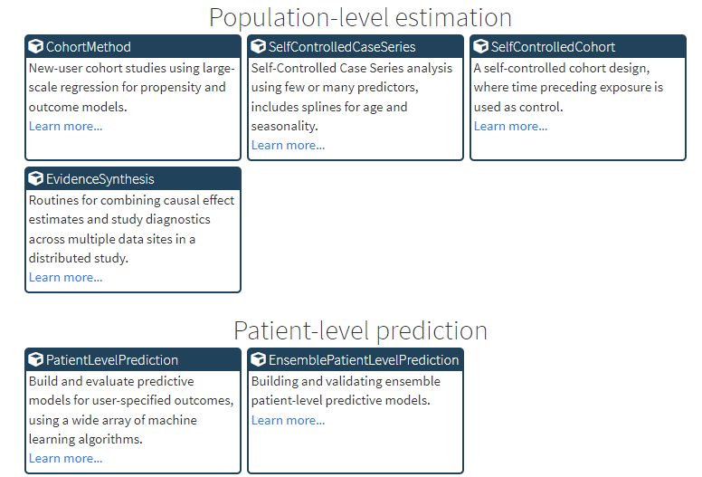
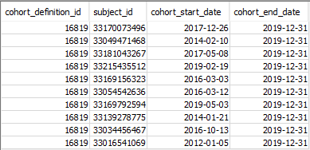
From cohort definition to analysis
ATLAS: Cohort Definition
JSON and SQL file
OMOP CDM
OHDSI Standardized analytics
COHORTS

Slide 6

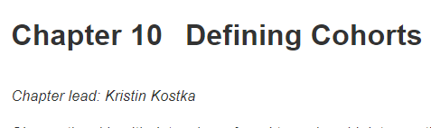

https://ohdsi.github.io/TheBookOfOhdsi/Cohorts.html

Slide 7
From cohort definition to analysis
ATLAS: Cohort Definition
JSON and SQL file
OMOP CDM
OHDSI Standardized analytics
COHORTS

Slide 8



Create cohort: identify patients of interest
Create concept sets: translate clinical idea into codes
a set of persons who satisfy one or more inclusion criteria for a duration of time
Cohort
Cohort entry event
Inclusion/ exclusion criteria
Cohort exit criteria
Cohort definition
A data-agnostic expression that defines one or more Standard Concepts encompassing the clinical entity of interest.
Concept Sets
Concept
Standard, non-standard
Source

Slide 9
Cohort definition
Cohort entry initial event
Cohort exit
Person timeline
Observation period start
Inclusion criteria observation (>=1)
Observation period end
Inclusion criteria temporal logic
Inclusion criteria temporal logic
Inclusion criteria absence (=0)

Slide 10
Concepts
Mapping Non-Standard to Standard Concepts
CONCEPT RELATIONSHIP
Non-standard Concepts
Standard Concepts
Classification
Concepts
Unique representation of a source code
The definitive representation in the OMOP CDM
Categories and classifications of Standard Concepts

Slide 11
TOOLS for creating cohort
ATLAS:
https://ohdsi.ndorms.ox.ac.uk:8443/Atlas/
https://atlas-demo.ohdsi.org/
ATHENA: https://athena.ohdsi.org/
CodelistGenerator: https://github.com/oxford-pharmacoepi/CodelistGenerator
Covid-19 as an example

Slide 12
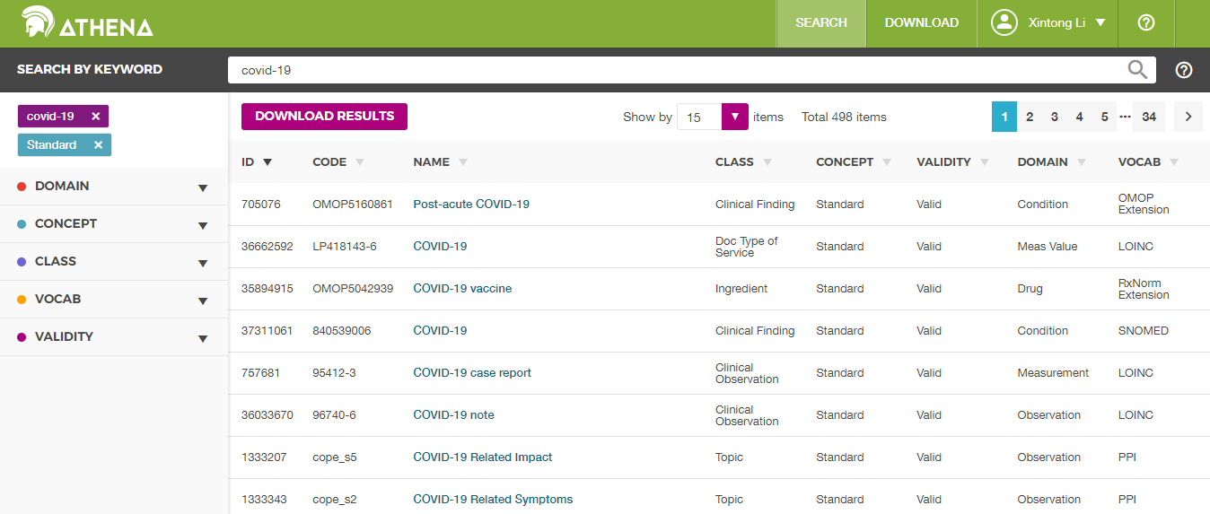
Athena knows Source Codes

Slide 13
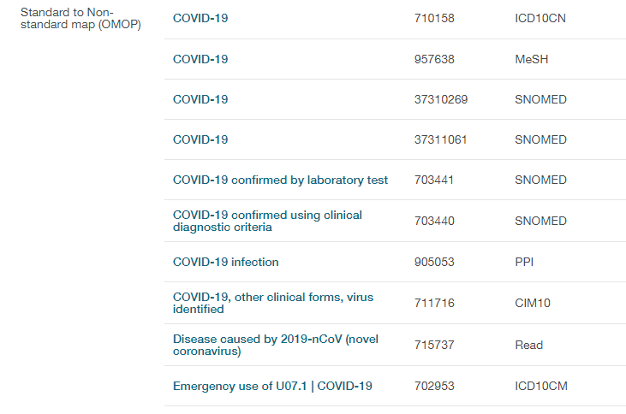
... and gives you the mapping

Slide 14
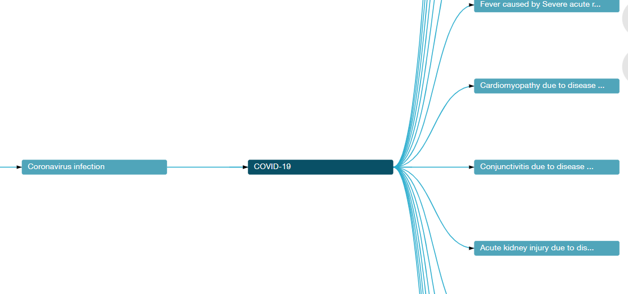
Hierarchy

Slide 15
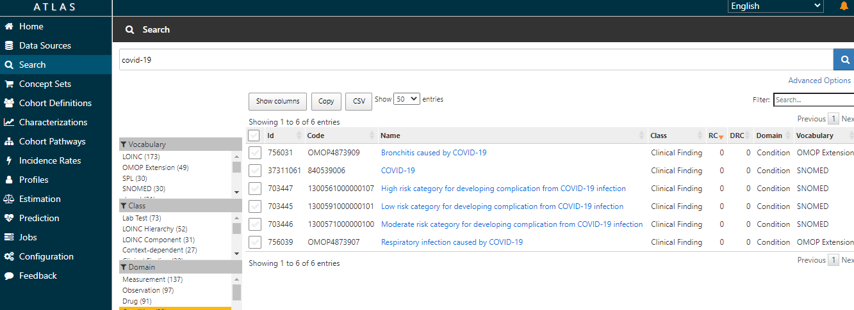
ATLAS: concept

Slide 16
Atlas: Cohort definition
Cohort entry initial event: Covid-19 diagnostics
Cohort exit
Person timeline
Observation period start
Inclusion criteria observation (>=1)
Observation period end
Inclusion criteria temporal logic
365 days observation prior index
Covid-19 Dx between 2021/06/01 – 2021/06/31
No covid-19 vaccine before
Inclusion criteria temporal logic
Inclusion criteria absence (=0)

Slide 17
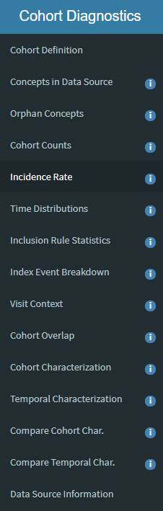

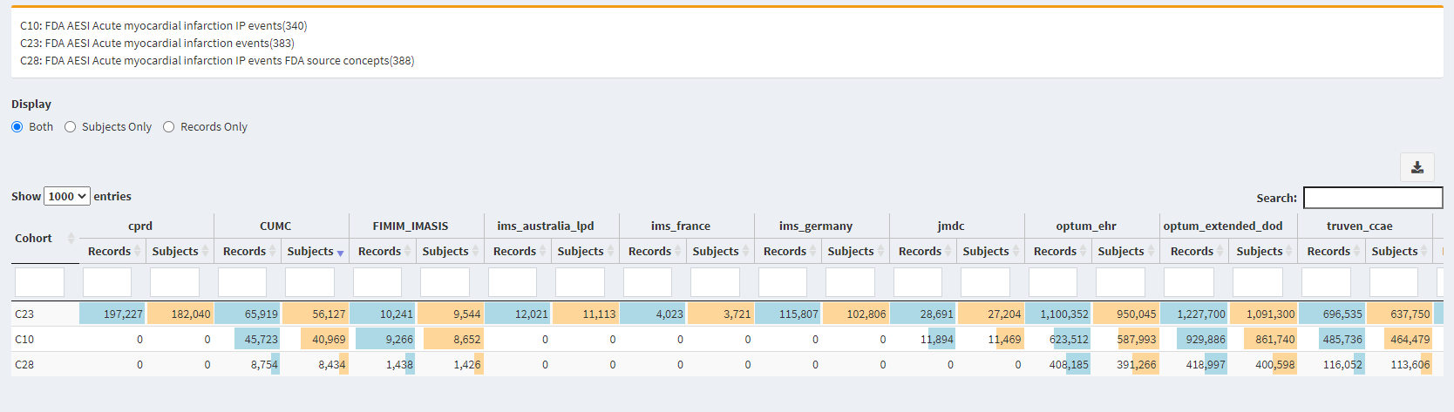
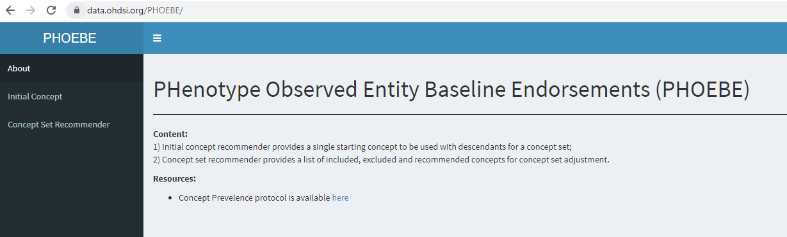
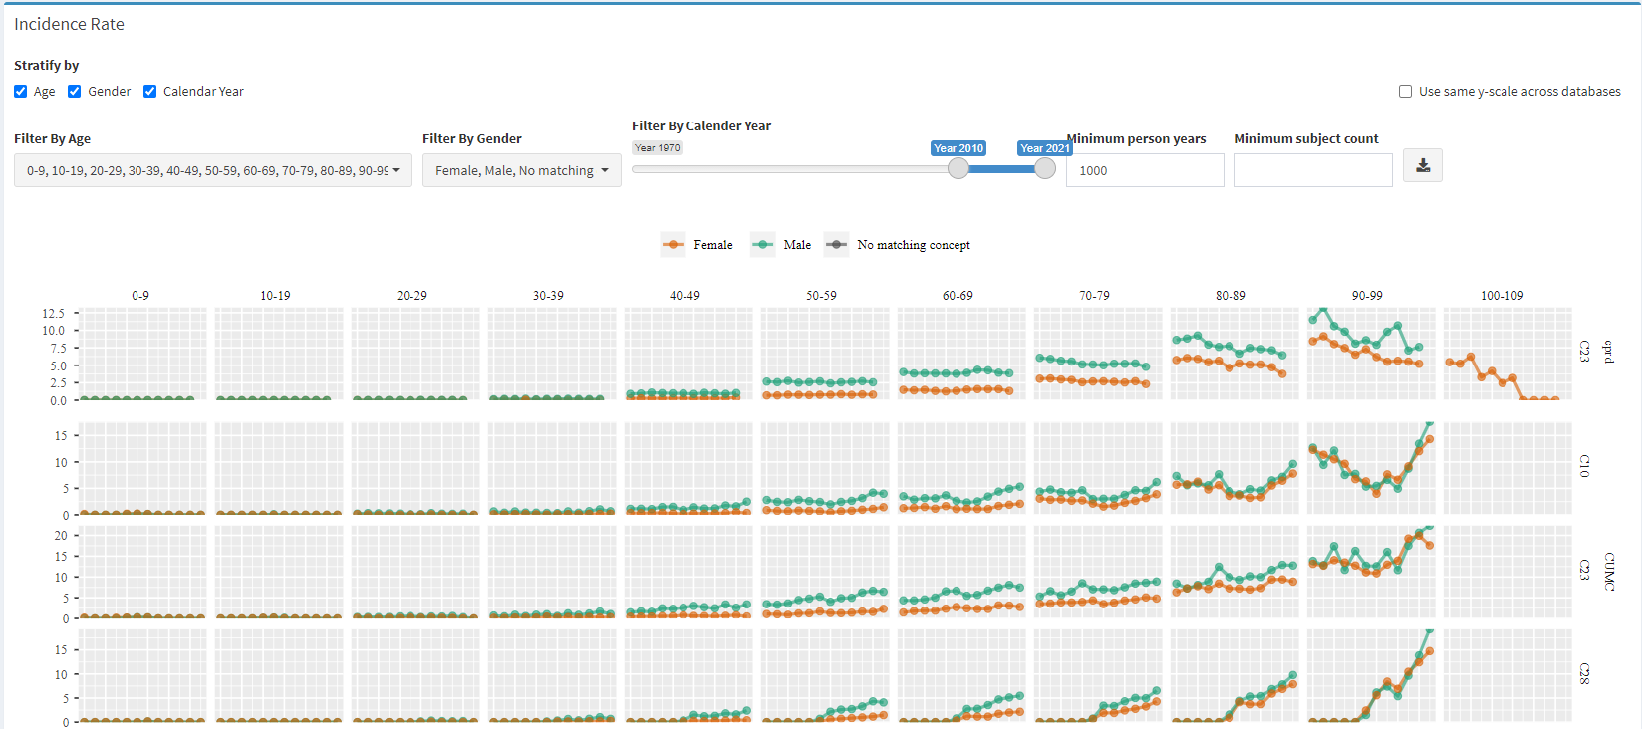
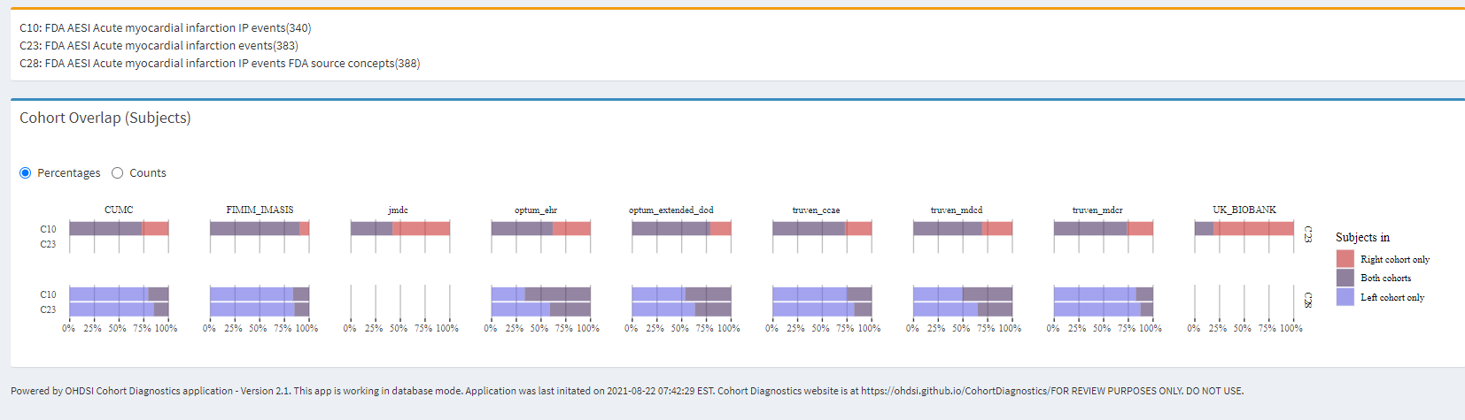
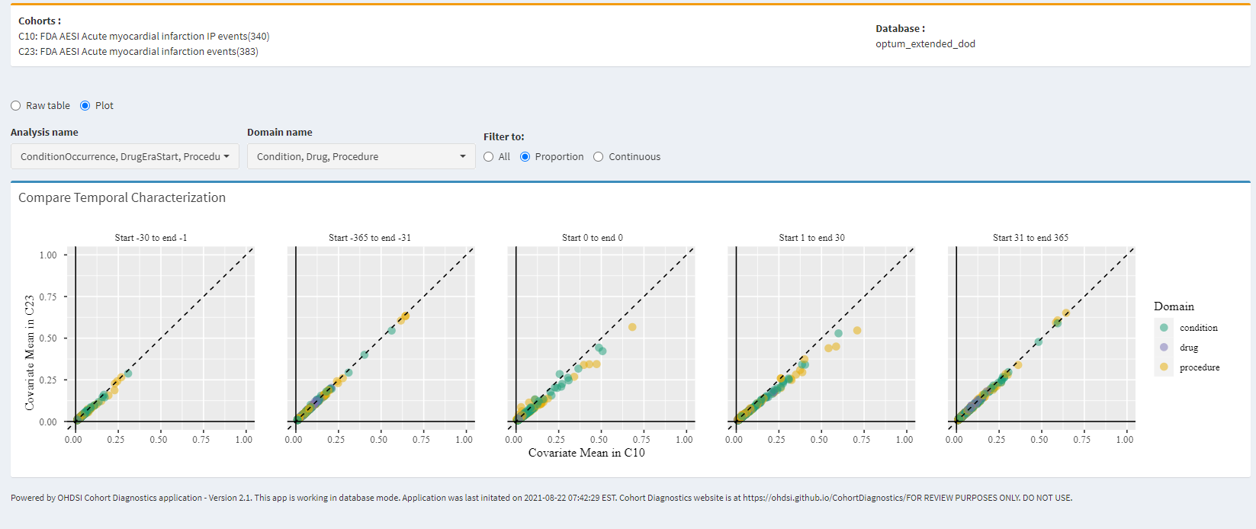
Developing the cohort
Cohort definition logic
Cohort diagnostics
Concept set expressions
Initial events
Conceptsets
Inclusion criteria
Conceptsets
Exit strategy
Conceptsets

Slide 18
Cohort Diagnostics
https://ohdsi.github.io/CohortDiagnostics/
Skeleton package
https://github.com/OHDSI/SkeletonCohortDiagnosticsStudy
https://dpa-pde-oxford.shinyapps.io/diagCovVaxExposures_CPRD/

Slide 19
From cohort definition to analysis
ATLAS: Cohort Definition
JSON and SQL file
OMOP CDM
OHDSI Standardized analytics
COHORTS

Slide 20
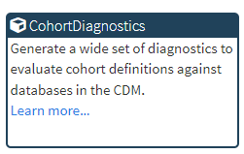
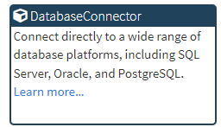
HADES: Health Analytics Data-to-Evidence Suite
https://ohdsi.github.io/Hades/

Slide 21
R package for distribution with data partners
https://github.com/oxford-pharmacoepi

Slide 22
Summary
Tool for creating cohorts:
ATLAS: initial search, build concept sets, cohort, generating study packages.
ATHENA: initial search, full hierarchy, source codes
CodelistGenerator
Notice: version of vocabulary, temporary codes
Tools for Standardized analytics:
HADES

Slide 23
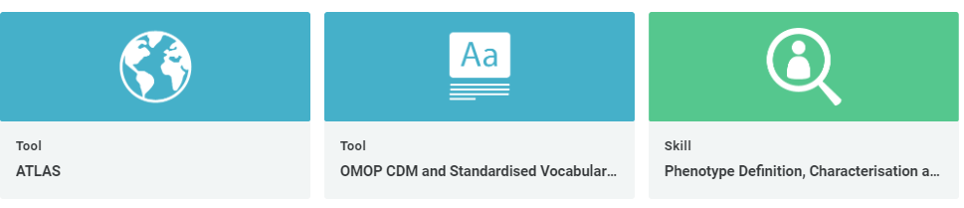
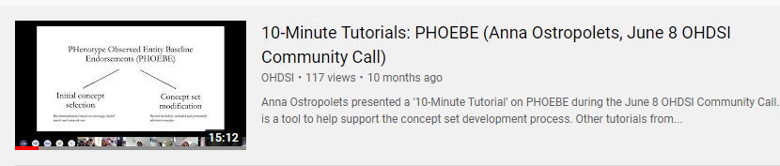
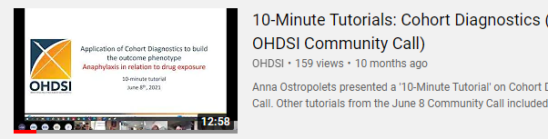
Resources
EHDEN Academy online courses: https://academy.ehden.eu/
Tutorials recording from previous OHDSI symposium or community call
https://www.youtube.com/user/OHDSIJoinTheJourney

Slide 24
THANK YOU

Slide 25

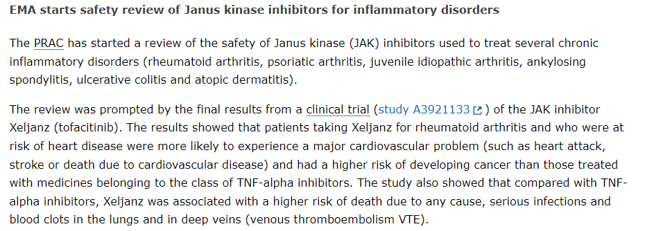
An example study
Notes:
https://www.ema.europa.eu/en/news/meeting-highlights-pharmacovigilance-risk-assessment-committee-prac-7-10-february-2022

Slide 26
Methods
Study design: comparative safety study
Exposure: JAK inhibitor : tofacitinib (Xeljanz)
Comparator: Tumor Necrosis Factor (TNF) Inhibitors: adalimumab (Humira)
Outcomes: deep vein thrombosis (DVT), Pulmonary Embolism (PE), venous thromboembolism (VTE; DVT or PE) and arterial thromboembolism (ATE)
Inclusion/ exclusion:
rheumatoid arthritis (RA), psoriatic arthritis (PsA), psoriasis (PsO)
New-user of either treatment
Age >= 50
1 years observation prior cohort entry

